Slide 1
Smart Grid Project
Designed by: Caleb Hubbell, Rudy Ku-cejin, tyler la-Brae

Slide 2
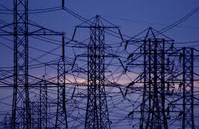
How it works
Power Generation
Power Distribution
Unbalanced Loads/Relays
Power balance/switches

Slide 3
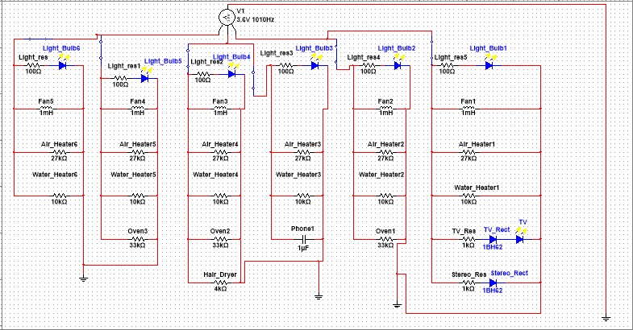
General arrangement

Slide 4
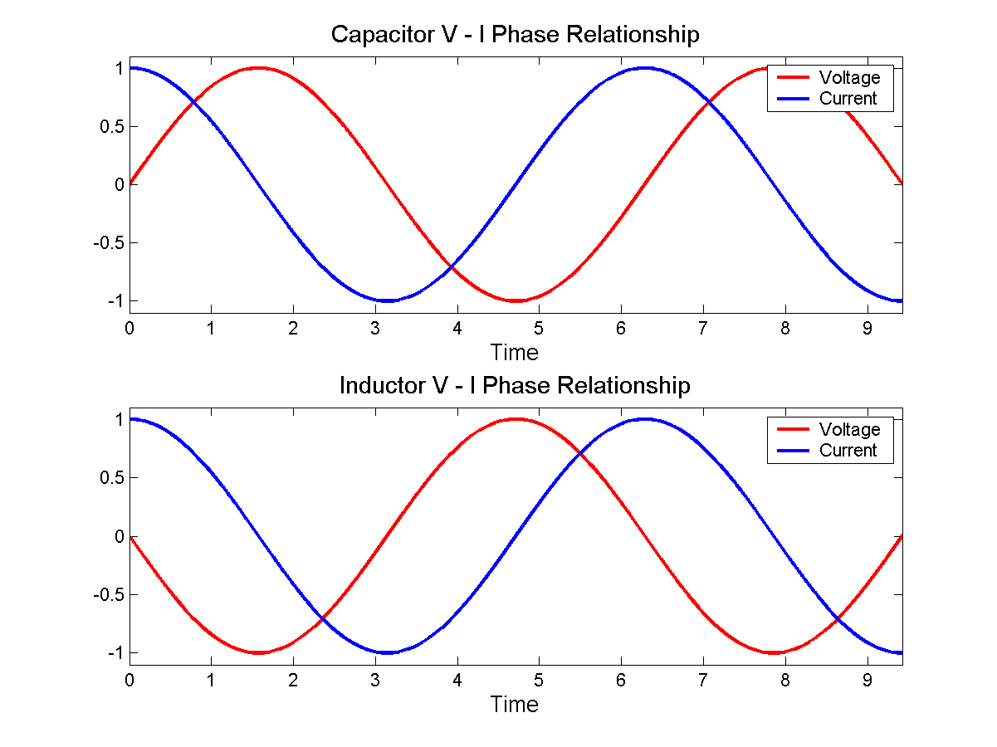
Power Issues
Capacitors
Inductors

Slide 5
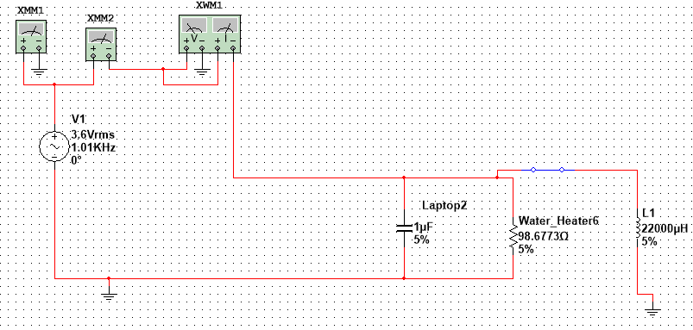
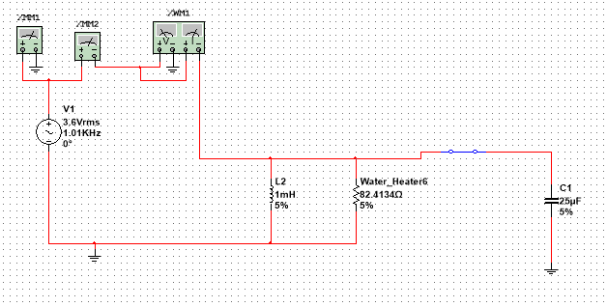
HANDELING POWER ISSUES (Power correction)

Slide 6



Why Should You Choose us?
Creative Model
Trials in Design
Experience
Empathy

Slide 7

Cost
Part | Price (USD) | Quantity | Sub-Total
Solar panel | $6.65 | 4 | $26.60
Capacitors | $6.57 | 1 | $6.57
Resistors | $12.90 | 1 | $12.90
Diodes | $3.25 | 1 | $3.25
Wire | $10.95 | 1 | $10.95
Inductors | $11.58 | 1 | $11.58
Total = $71.85

Slide 8

Problems Encountered And how they were handled
Misinterpretation of specifications
Buttons!
Errors in calculation (LED, Capacitors and inductors)
Time crunch

Slide 9
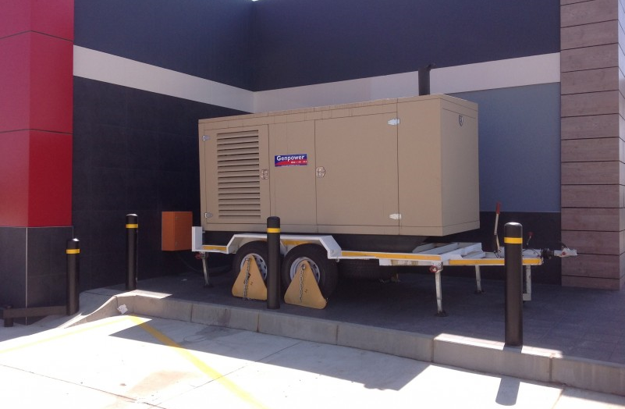
How our Design Solves YOUR problems
Maximum energy saved
No off phase issues
Smart grid
Reliable Energy

Slide 10

Conclusion
Energy will be saved
Money saved

Slide 11
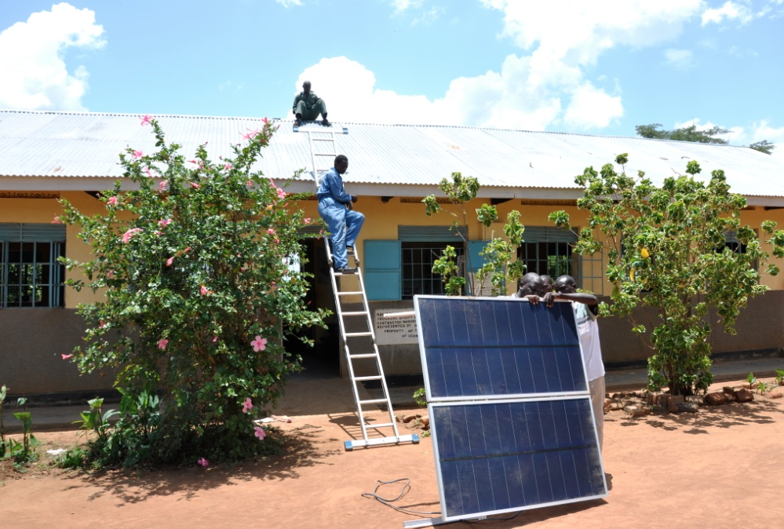
Future Improvement Ideas
Solar Panels
DC Power for the village

